Slide 1
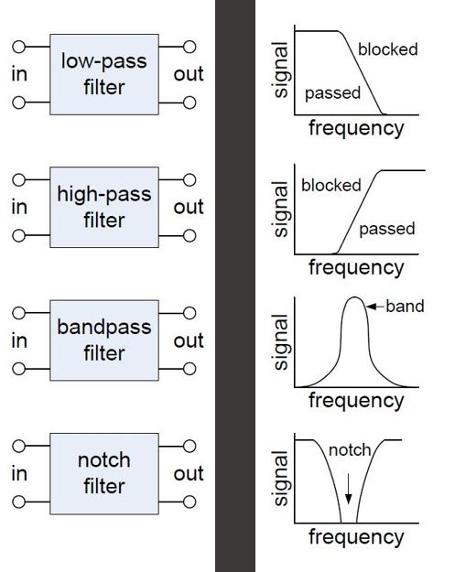
Filtering and Working in the Frequency Domain
Mar-2019

Slide 2
Tonight
Learn how to think in terms of the frequency domain
2. Understand basic filter types
3. Practical examples
4. Power supply bypassing/filtering

Slide 3
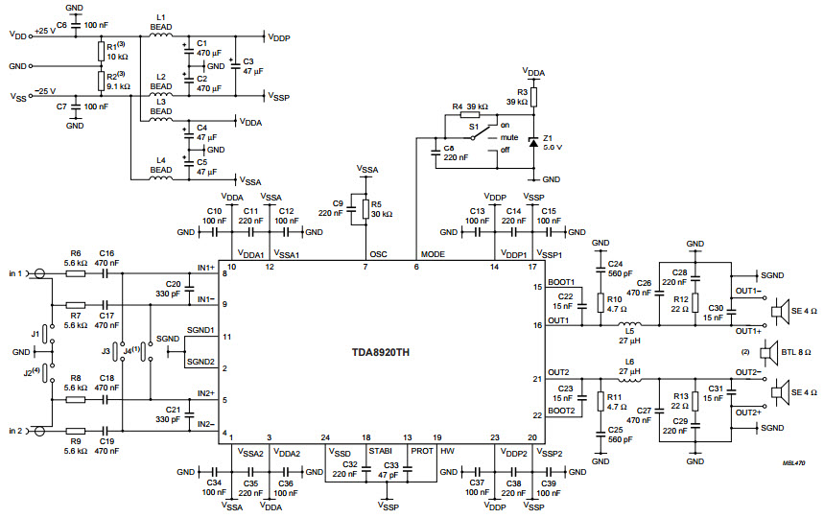
Intimidating? Check back after class!

Slide 4
Why use filters?
Part of moving from functional to functioning WELL
(Almost) all power supplies need filtering
Mechanical switches
Audio electronics
Cross-overs
Equalizers
Class D audio amplifiers need filtering
Analog/mixed-signal electronics
Sensor noise
Analog-Digital signal conversion
Digital-Analog signal conversion

Slide 5
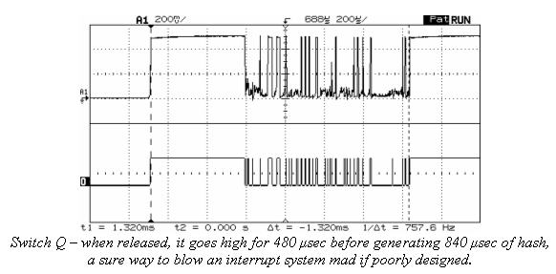
Switch Debouncing

Slide 6
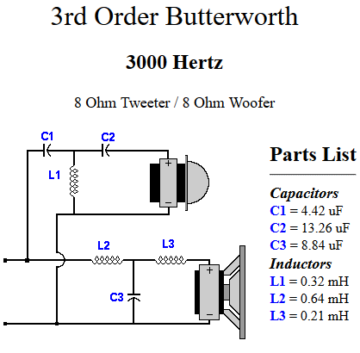
Speaker Crossover
https://www.diyaudioandvideo.com/Tutorial/DesignBuildCrossover/

Slide 7
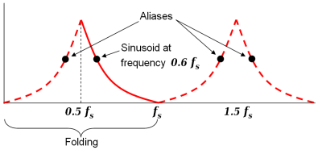
ADC Example - Aliasing
https://en.wikipedia.org/wiki/Nyquist_frequency

Slide 8
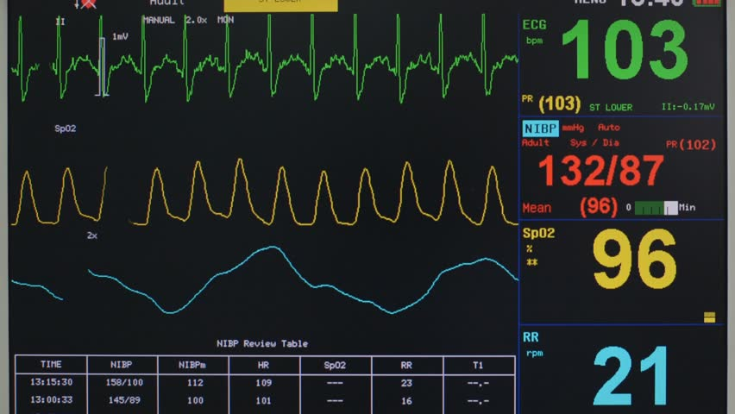
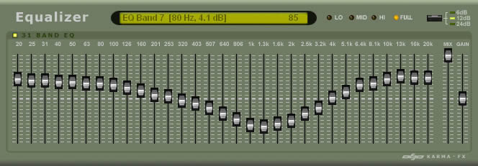
Time vs Frequency Domain

Slide 9
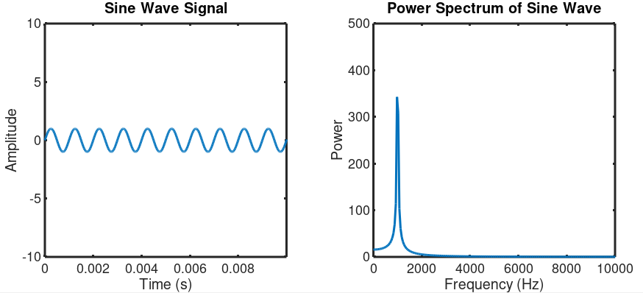
Time vs Frequency Domain
Freq = 1/Period = 1/0.001s = 1000Hz
Period = 0.001s
Frequency = 1 / Period

Slide 10
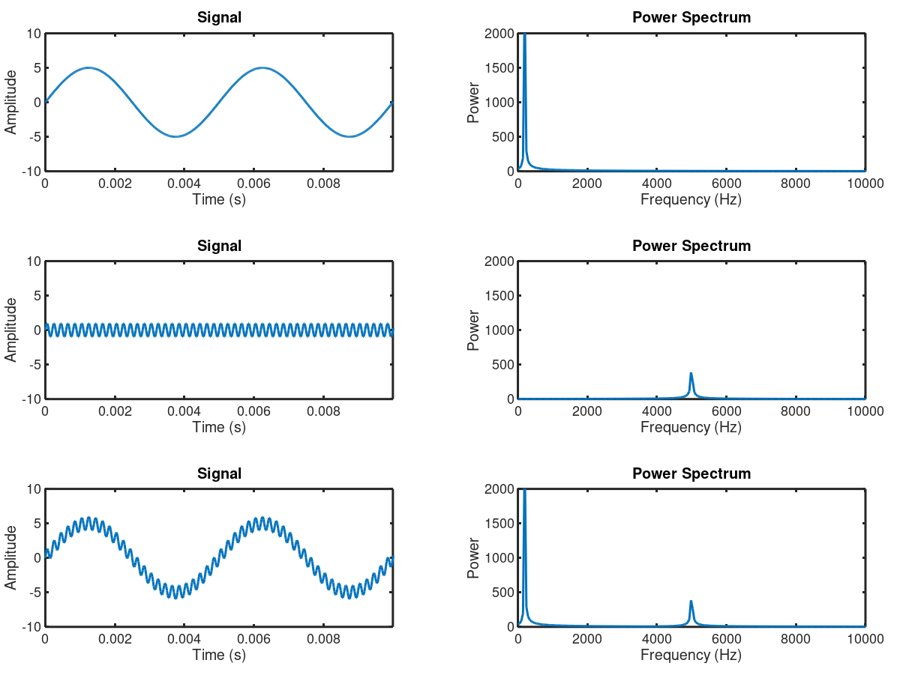
2 Sine Waves Added Together

Slide 11
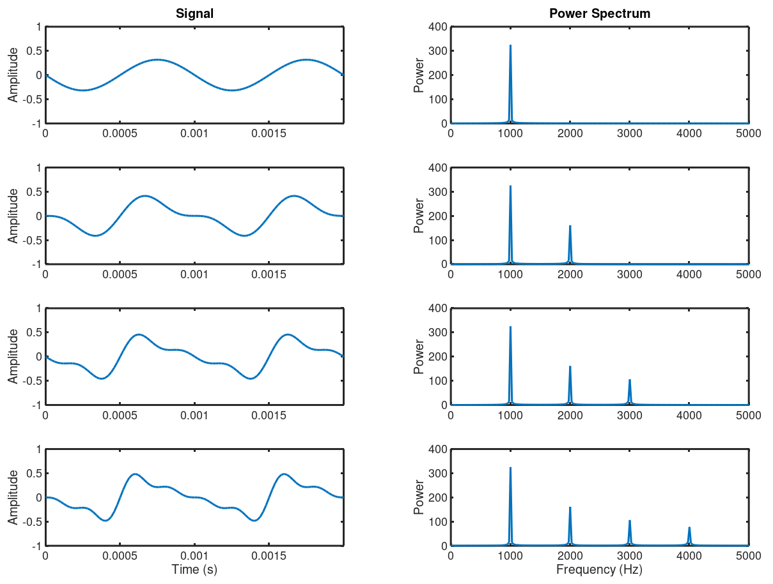
Creating a Waveform from “Harmonics”

Slide 12
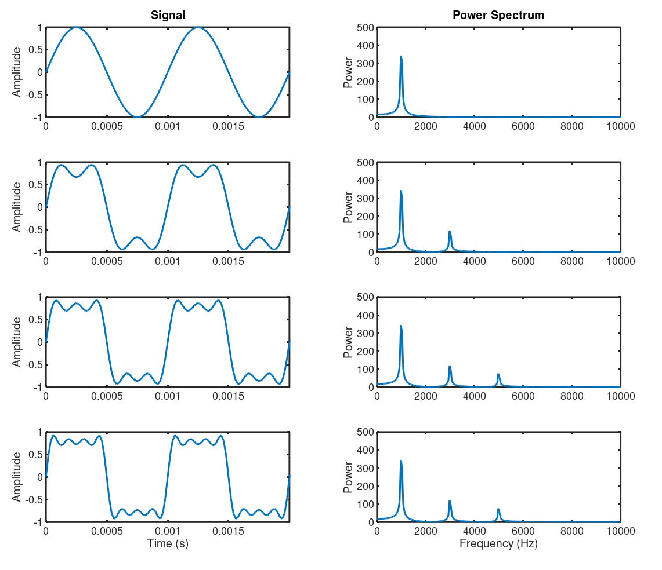
Square Wave = Odd Harmonics

Slide 13
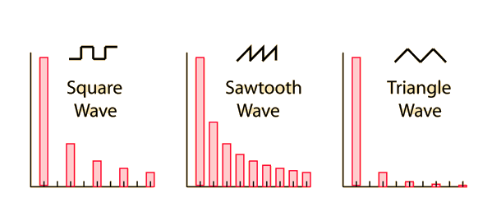
Common Waveforms
Note: vertically symmetric waveforms tend not to have even harmonics

Slide 14
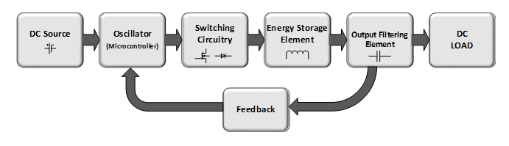
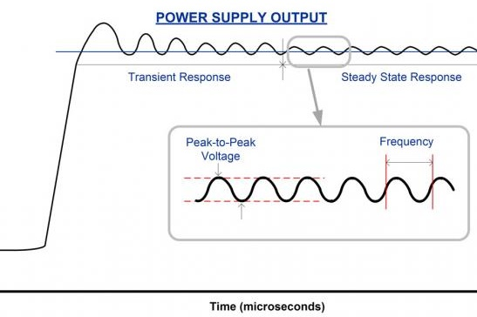
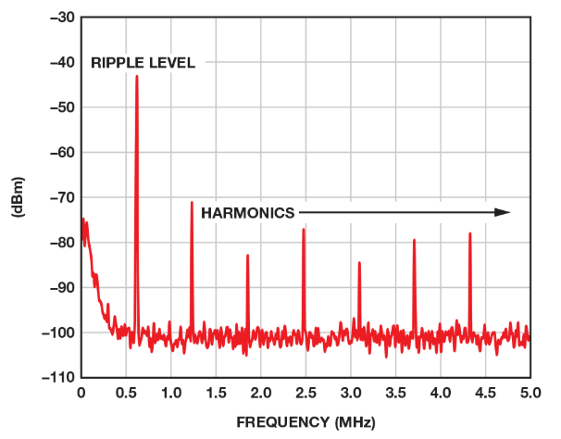
Switching Power Supply Noise

Slide 15
Switch Debouncing
What frequencies might need to be retained vs rejected?

Slide 16
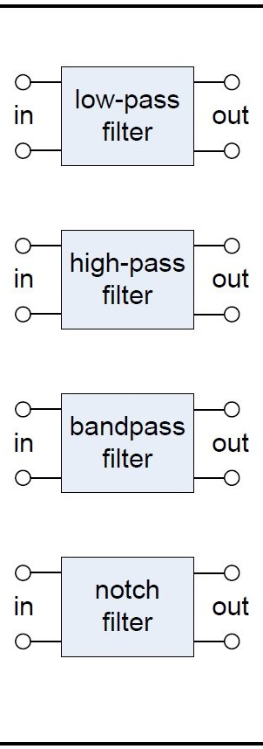
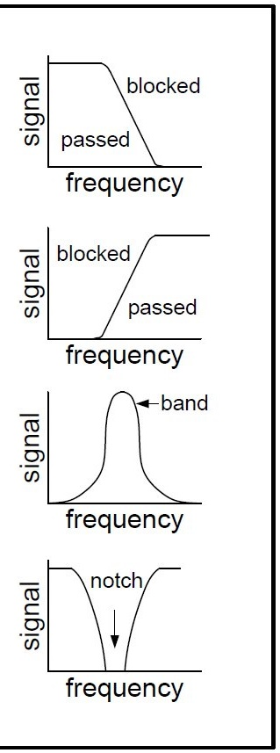
Types of Filters

Slide 17
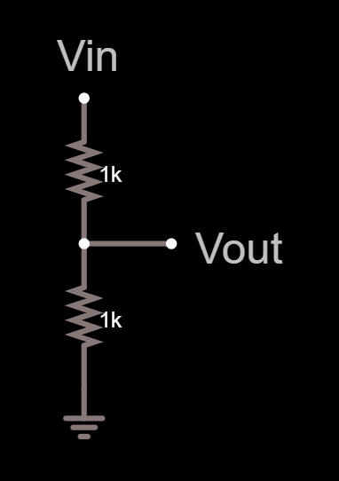
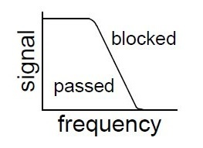
A Conceptual Low Pass Filter
All-pass
Low-pass
Decreases with frequency

Slide 18
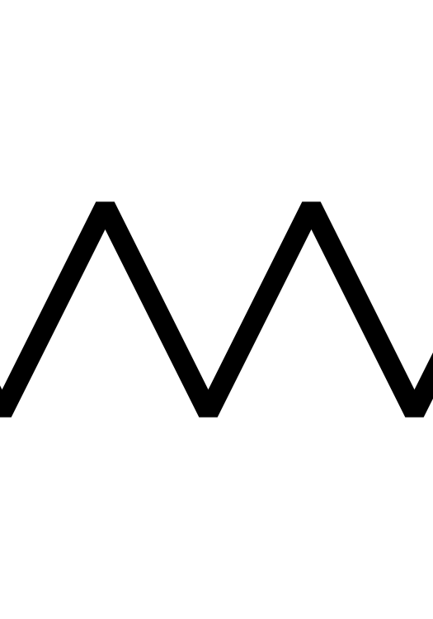
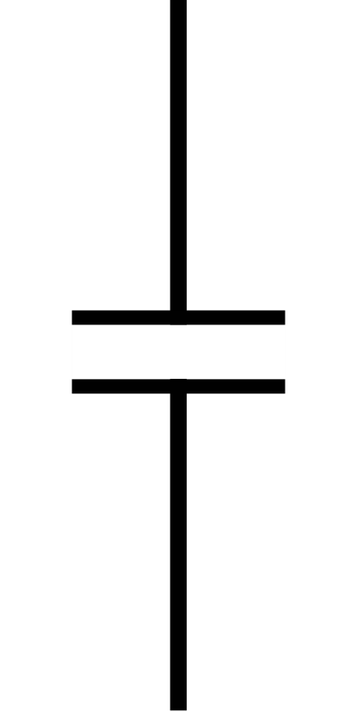
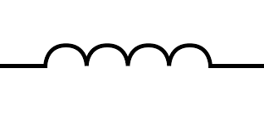


RLC Components vs Frequency
DC Resistance/ AC Reactance
Change w/ freq?
R
$$XC∝ \frac{−1}{fC}$$
$$XL∝fL$$

Slide 19
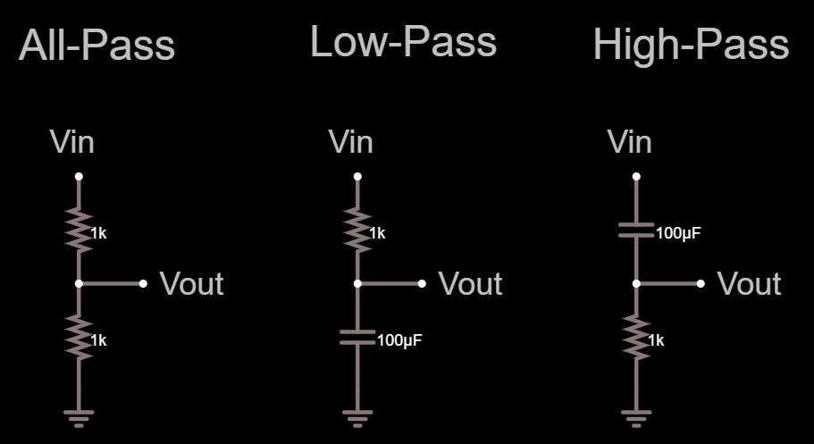
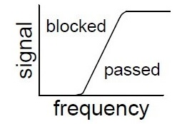
RC Filters
Decreases with frequency

Slide 20
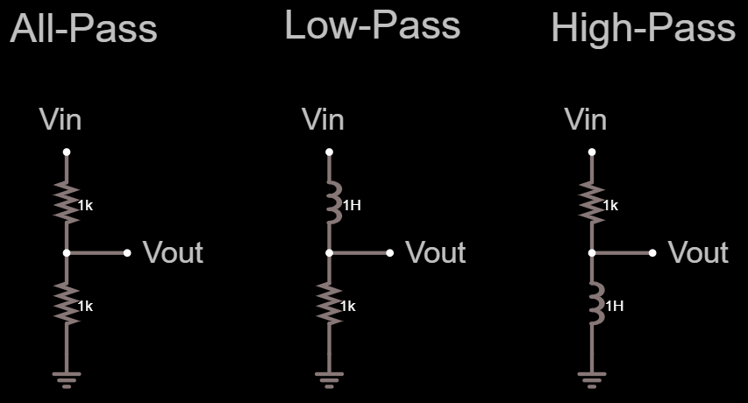
LC Filters
Increases with frequency

Slide 21
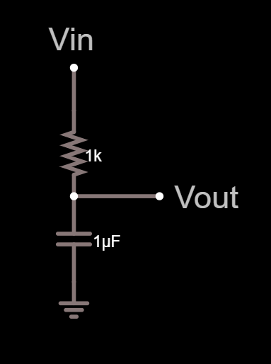
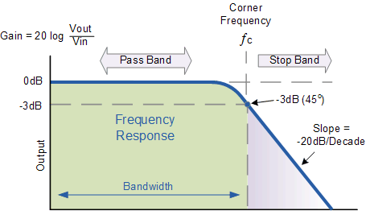



RC Low Pass Filter
$$fc=\frac{1}{RC}$$
$$fc=1/{(1000×1x{10}^{−6})}$$
$fc=1/{0.001}$ $=$ $1000$ Hz
-3dB =0.707
-20dB = 0.1

Slide 22
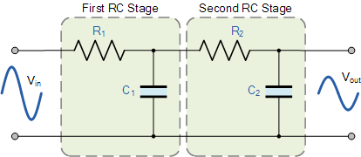
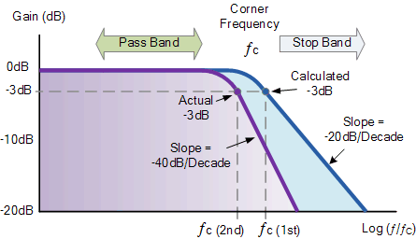
2nd Order Low Pass Filter

Slide 23
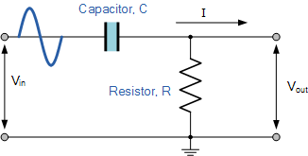
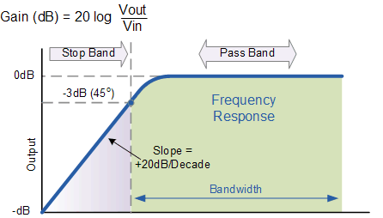

RC High Pass Filter
$$fc=\frac{1}{RC}$$

Slide 24
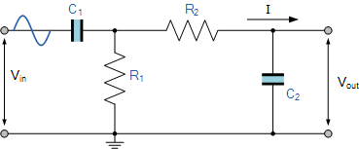
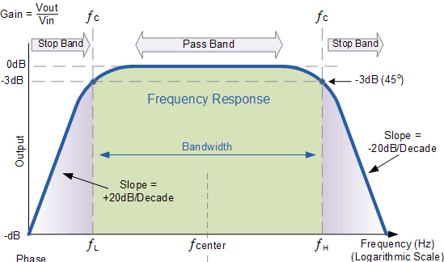


RC Band Pass Filter
$$fL=\frac{1}{R2C2}$$
$$fU=\frac{1}{R1C1}$$

Slide 25
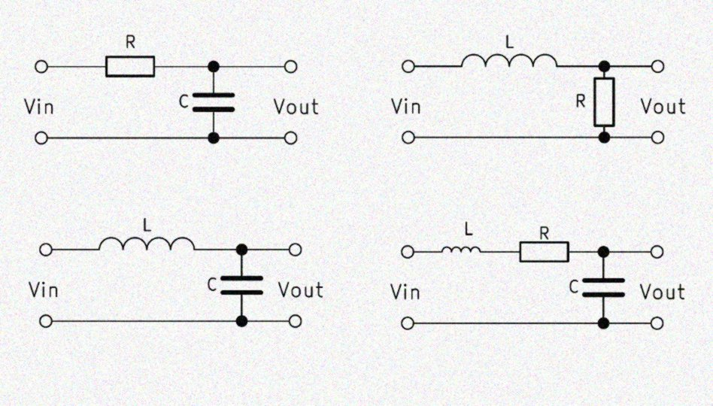
Low Pass Filter Variations

Slide 26
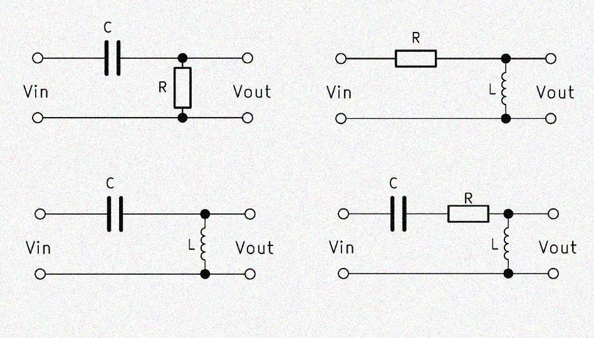
High Pass Filter Variations

Slide 27
Practical Example - Crossover

Slide 28
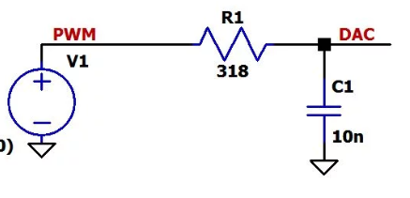
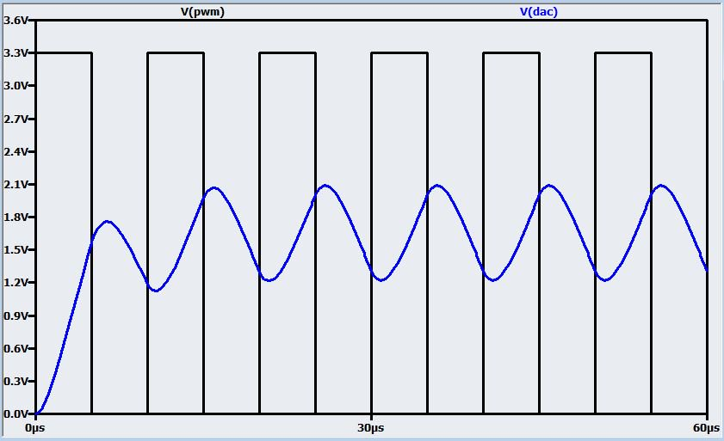
Example: Arduino PWM Filtering

Slide 29
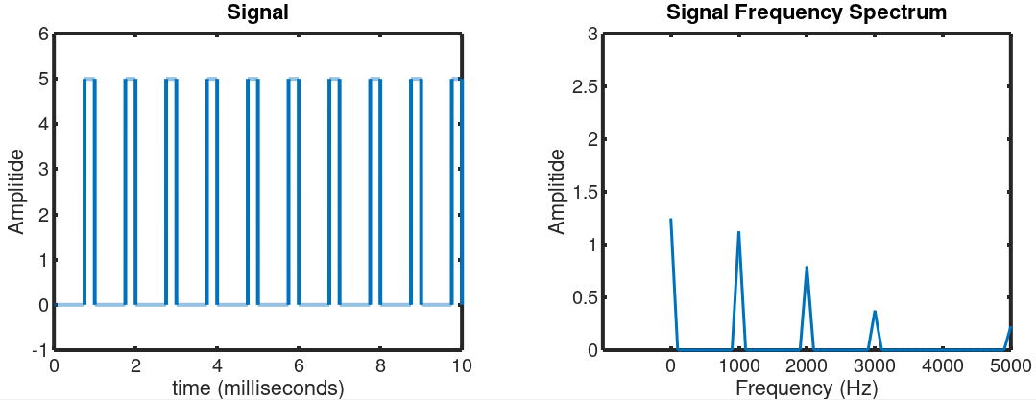
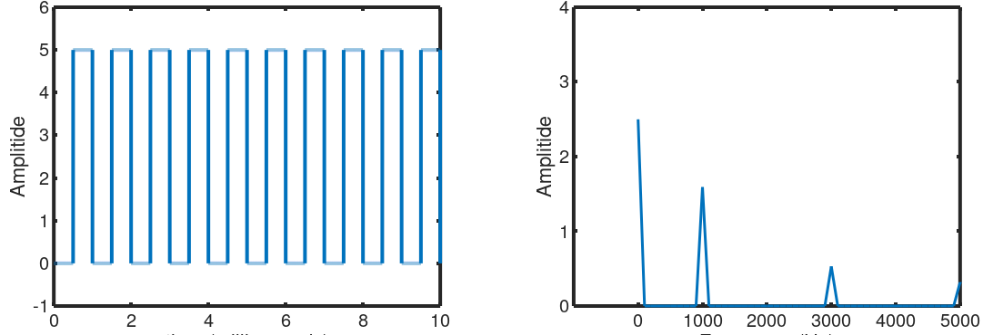
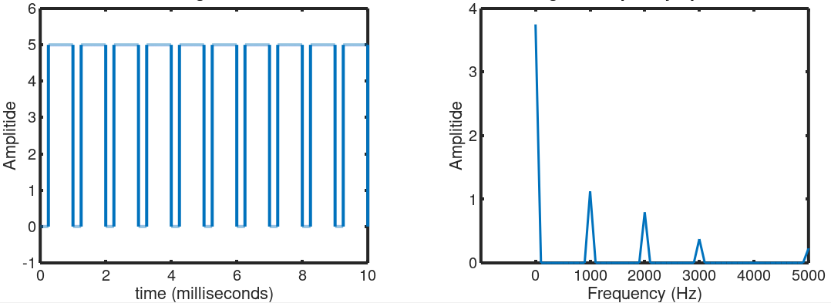
PWM Freq Components
25% Duty Cycle
50% Duty Cycle
75% Duty Cycle

Slide 30
Power Supply Noise and Bypassing

Slide 31
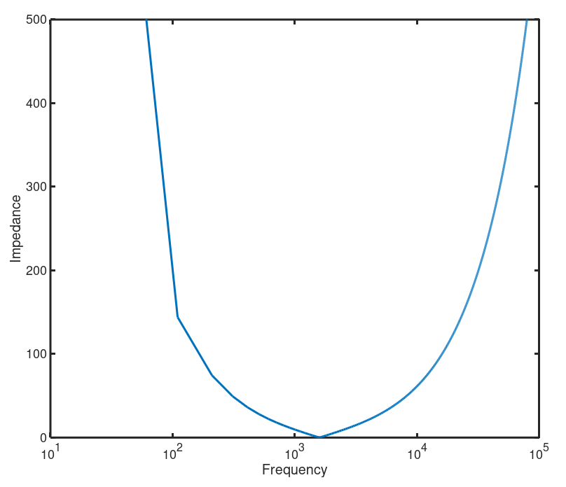


LC Resonant Circuit Detail
Capacitor
dominates
C
Inductor
dominates
L
Resonant
frequency
$$XC= \frac{−1}{2πfC}$$
$$XL=2πfL$$

Slide 32
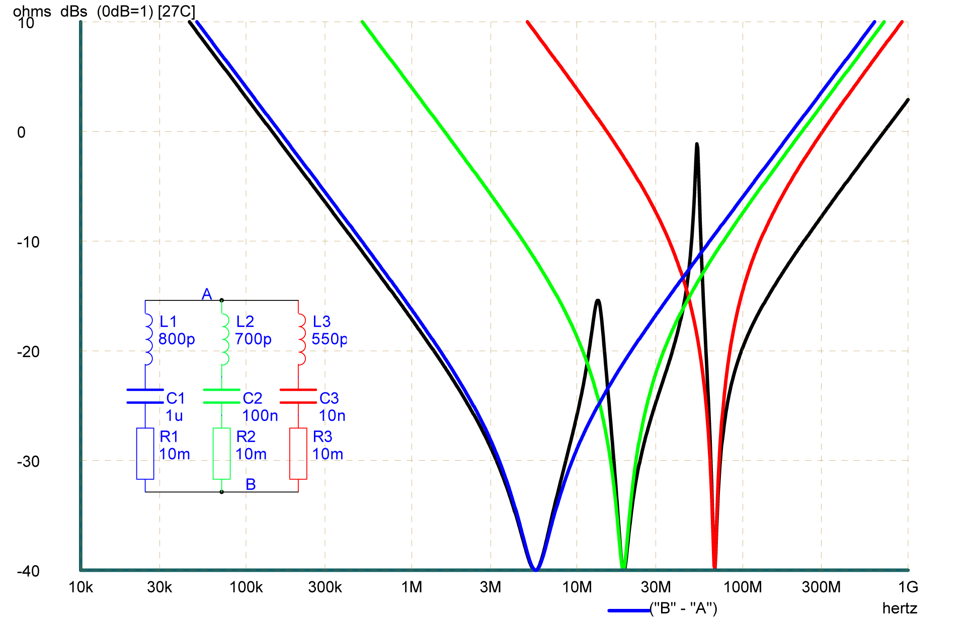
Real World Capacitor Bypassing
[0.01uF]
[1Ω]
[0.1uF]
[1uF]
[0.1Ω]
[0.01Ω]
Source: https://www.planetanalog.com/document.asp?doc_id=527551

Slide 33
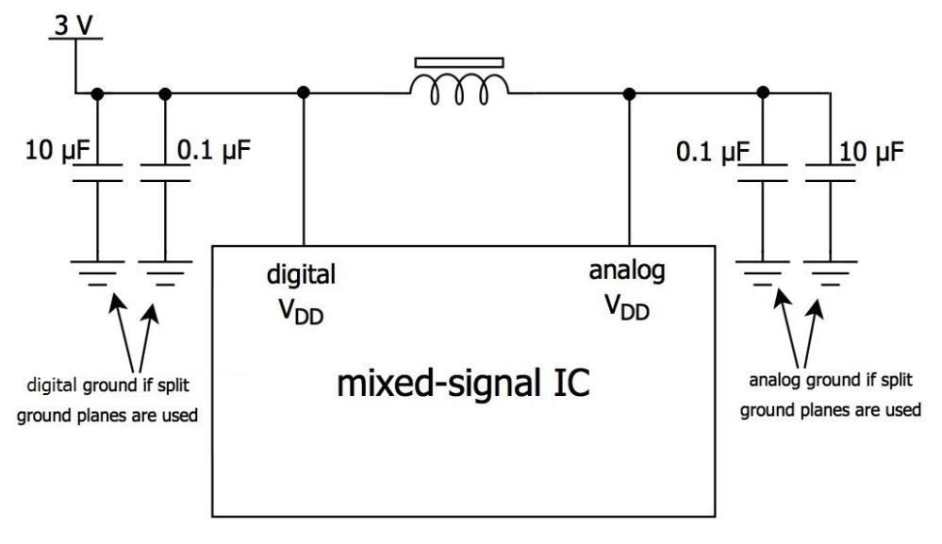
Filter Digital Noise From Analog
L
A ferrite bead is sort of a poor (lossy) inductor, converting AC to heat
Source: All About Circuits: Choosing and Using Ferrite Beads

Slide 34
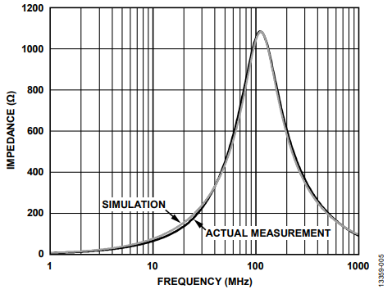
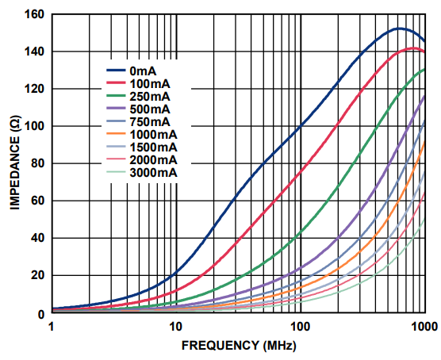
Ferrite Bead Notes
L
Tyco BMB2A1000LN2
TDK MPZ1608S101A
Choose bead for high impedance @ freq of interest
Choose current rating ~5x higher than bias
From: Analog Devices AN-1368 Ferrite Bead Demystified

Slide 35
Let’s take another look!

Slide 36
Week 2: Lab Time!
Option 1: Microcontroller PWM Filter
Build RC low pass filter
Adjust, measure with oscilloscope
Option 2: Analog Switch Debounce
Build RC low pass filter
Adjust, measure with oscilloscope

Slide 37
Pre-Class Review
https://www.youtube.com/watch?v=EQtwsWJuUPs
https://www.youtube.com/watch?v=vN9aR2wKv0U
https://www.youtube.com/watch?v=EQtwsWJuUPs&list=PLRIGIzu0Z7KlBkiI9nNfMmRy4ZTzGr0RN&index=15&t=0s

